Slide 1


TERNA ENGINEERING COLLEGE
DEPARTMENT OF COMPUTER ENGINEERING
Online voting system using blockchain
UNDER THE GUIDANCE OF :
Prof. Dnyaneshwar Thombre
PROJECT MEMBERS :
C-28 :Harsh A. Minde
C-44 :Jyotiraditya A. Patil
C-63 :Ameya A. Mane
C-23 :Atharva S. Birje
ACADEMIC YEAR:
2024-25

Slide 2
INDEX
INTRODUCTION
ABSTRACT
LITERATURE REVIEW
PROBLEM STATEMENT & OBJECTIVE
TRADITIONAL VOTING SYSTEM
REASON FOR TOPIC SELECTION
HARDWARE & SOFTWARE USED
PROJECT FLOW
CONCLUSION & FUTURE SCOPE
REFERENCE

Slide 3
INTRODUCTION
In recent years, the integration of advanced technologies into various aspects of our daily lives has become increasingly prevalent. One such application is the utilization of blockchain technology for online voting systems. Traditional voting methods, such as paper ballots or electronic voting machines, are gradually being replaced by more sophisticated and secure solutions.
Blockchain technology, a decentralized digital ledger system, has gained popularity due to its transparency, immutability, and security. This technology ensures that each vote is recorded accurately and cannot be altered, providing a tamper-proof system. Applying blockchain to online voting systems brings forth numerous benefits, including enhanced voter privacy, increased trust in the electoral process, and prevention of fraud.

Slide 4
ABSTRACT
Transparency and Trust: Ensures transparency in the voting process by providing a public ledger accessible to all participants.
Security and Integrity: Protects the integrity of the vote by preventing tampering and ensuring that each vote is recorded accurately.
Decentralization: Eliminates the need for a central authority, distributing the control of the voting process across a decentralized network.
Immutability: Guarantees that once votes are recorded, they cannot be altered, ensuring a permanent and tamper-proof record.
Voter Privacy: Ensures voter anonymity and privacy through advanced cryptographic techniques, safeguarding voter identity.
Accessibility and Convenience: Provides an easy-to-use platform accessible from anywhere, increasing voter participation and convenience.

Slide 5
LITERATURE REVIEW
Sr. No. | Project Title | Author | Summary
1. | Blockchain Enabled Online-Voting System | Akhil Shah, Nishita Sodhia, Shruti Saha, Soumi Banerjee, Madhuri Chavan​ 2020 | This research proposes a secure, transparent online voting system using blockchain technology. It employs an Android app with AES-128 encryption, SHA-256 hashing, fingerprint authentication, and OTP verification. Votes are recorded on the Ethereum blockchain, ensuring tamper-proof and efficient election processes, with scalability for national use.
2. | A Scalable Implementation of Anonymous Voting over Ethereum Blockchain | Jae-Geun Song, Sung-Jun Moon, Ju-Wook Jang 2021 | This research addresses the scalability challenges in anonymous voting systems on the Ethereum blockchain. The proposed scheme optimizes gas consumption, reduces time complexity, and resolves tallying failures caused by the absence of votes from registered voters. The system uses algorithmic improvements to enhance performance, ensuring a scalable and efficient voting process. While the solution significantly lowers transaction costs and improves scalability, it does not delve deeply into privacy issues and assumes reliable user interfaces for private key management.
Sr. No.
Project Title
Author
Publishing date
Summary

Slide 6
Sr. No. | Project Title | Author | Summary
3. | Implementation of Decentralized Blockchain E-voting | Saad Moin Khan, Aansa Arshad, Gazala Mushtaq, Aqeel Khalique, Tarek Husein 2018 | This research proposes a decentralized electronic voting system using blockchain technology to enhance security, transparency, and reliability. The system leverages Ethereum blockchain and smart contracts to ensure immutable and verifiable votes. It addresses common e-voting issues like hacking and vote tampering. The solution utilizes tools such as Ganache, Truffle, NPM, and Metamask for secure vote casting and management. Though it significantly reduces security risks, the paper notes the need for addressing scalability concerns in large-scale elections.
4. | Decentralized Voting Platform Based on Ethereum Blockchain | David Khoury, Elie F. Kfoury, Ali Kassem, Hamza Harb 2020 | This research introduces a decentralized voting platform utilizing the Ethereum blockchain to ensure secure, transparent, and tamper-proof elections. The system employs smart contracts to handle voting processes, enhancing the security and transparency of the voting system. The decentralized nature of the platform eliminates the need for a trusted third party, providing a reliable and robust voting mechanism. Although the paper primarily focuses on security and transparency, it highlights the need for addressing scalability concerns for broader adoption.

Slide 7
PROBLEM STATEMENT
PROBLEM STATEMENT :
Traditional voting methods suffer from vulnerabilities, inefficiencies, and security concerns. Manual processes and outdated electronic systems are prone to errors, susceptible to tampering, and lack transparency. The need for a modern, secure, and transparent voting system is evident, especially in light of increasing demands for trustworthy electoral processes. Governments and organizations are seeking a solution that addresses these challenges effectively. Blockchain technology emerges as a promising alternative to revolutionize online voting, providing transparency, security, and enhanced trust in the electoral process.

Slide 8
OBJECTIVE
OBJECTIVE :
1.Enhance Security
2. Increase Transparency
3. Ensure Voter Privacy
4. Improve Accessibility
5. Guarantee Immutability
6. Reduce Costs
7. Enhance Trust
8. Facilitate Real-Time Results

Slide 9
TRADITIONAL VOTING SYSTEM
Electronic Voting Machines (EVMs) have been used in India for several decades to ensure efficient and accurate voting during elections. Here are some key details about EVMs in India:
Summary:
Number of EVMs: Approximately 1.8 million for general elections.
Cost per EVM: ₹17,000 to ₹20,000 ($200 to $250).
Personnel: Each polling booth is managed by a team of polling officials, supported by technical staff and security personnel.

Slide 10
REASON FOR TOPIC SELECTION
In light of the extensive logistical and financial demands of traditional voting methods, our project focuses on enhancing the electoral process's efficiency and security.
These challenges underscore the need for an innovative solution like our blockchain-enabled online voting system, which promises to streamline operations, reduce costs, and enhance security.

Slide 11
HARDWARE USED
Mobile Devices:
Smartphones (iOS and Android)
Tablets (iOS and Android)
Servers:
Blockchain nodes servers
Backend servers
Networking Equipment:
Routers
Switches
Firewalls
Cryptographic Hardware:
Hardware Security Modules (HSM)
Secure Key Storage Devices
Development and Testing Hardware:
Laptops/Desktops for developers
Test devices (various models of smartphones and tablets)
6.Cloud Infrastructure:
Cloud servers (AWS, Google Cloud, Azure)
Cloud storage solutions
7.Security Hardware:
Biometric authentication devices (optional, for enhanced security)
Two-factor authentication (2FA) devices

Slide 12
SOFTWARE USED
1.Blockchain Platforms:
- Ethereum
- Hyperledger Fabric
2. Smart Contract Development:
- Solidity
- Vyper
3. Cryptographic Libraries:
- OpenSSL
- libsecp256k1
4. Mobile App Development Frameworks:
- React Native
- Flutter
5. Backend Development:
- Node.js
- Express.js
6. Database:
- IPFS (InterPlanetary File System)
- Firebase
- MongoDB
7. Development and Testing Tools:
- Truffle
- Ganache
- Remix IDE
8. Security and Auditing Tools:
- MythX
- Securify
9. API Integration:
- Web3.js
- Ethers.js
10. Deployment and Hosting:
- Docker
- Kubernetes

Slide 13
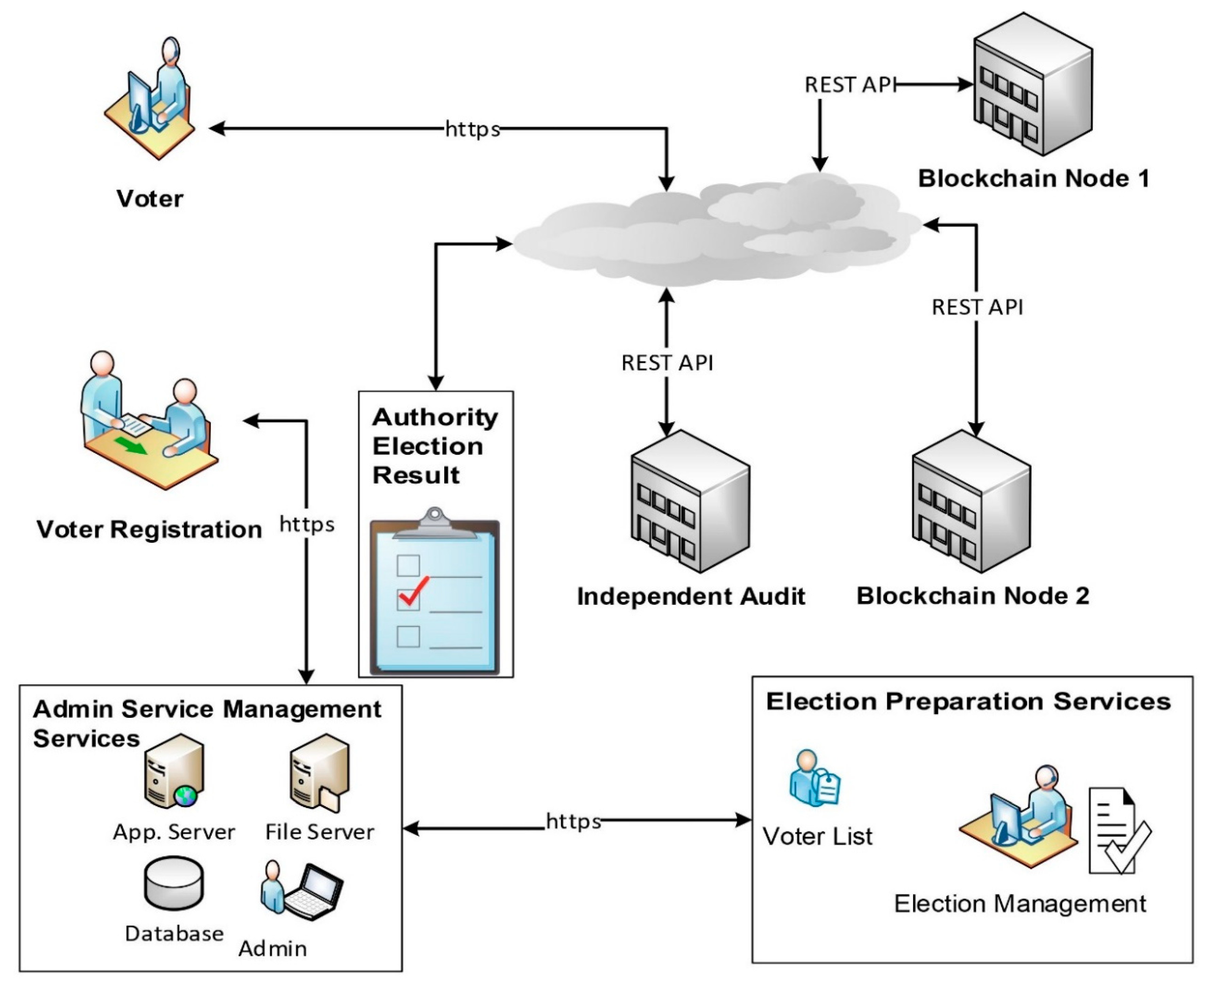
PROJECT FLOW

Slide 14
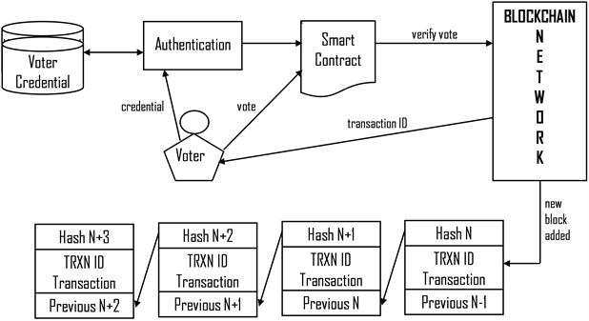

Slide 15
CONCLUSION & FUTURE SCOPE
CONCLUSION :
The integration of blockchain technology into online voting systems offers a transformative solution to the challenges of traditional voting methods. By ensuring security, transparency, and voter privacy, blockchain-based voting can significantly enhance trust in the electoral process. Additionally, the use of mobile applications increases accessibility and convenience for voters. This innovative approach promises a more secure, efficient, and reliable voting system for future elections.

Slide 16
CONCLUSION & FUTURE SCOPE
FUTURE SCOPE:
Scalability: Enhancing blockchain infrastructure to support large-scale national and international elections.
2. Interoperability: Developing standards for seamless integration with existing electoral systems and other blockchain networks.
3. Advanced Security: Implementing advanced cryptographic techniques and AI-driven security measures to further protect against emerging threats.
4.Enhanced User Experience: Improving the mobile app interface and functionality to provide a more intuitive and user-friendly voting experience.
5.Regulatory Compliance: Adapting to evolving legal frameworks and ensuring compliance with international voting regulations.
6.Increased Adoption: Promoting the adoption of blockchain-based voting systems in more countries and organizations.

Slide 17
REFERENCE
Research Papers and Articles:
Akhil Shah, Nishita Sodhia, Shruti Saha, Soumi Banerjee, Madhuri Chavan (2020). "Blockchain Enabled Online-Voting System," ITM Web of Conferences, 32, 03018.
Jae-Geun Song, Sung-Jun Moon, Ju-Wook Jang (2021). "A Scalable Implementation of Anonymous Voting over Ethereum Blockchain," IEEE Access, 9, 37930-37942.
Saad Moin Khan, Aansa Arshad, Gazala Mushtaq, Aqeel Khalique, Tarek Husein (2018). "Implementation of Decentralized Blockchain E-voting," International Journal of Computer Applications, 182(20), 1-5.
David Khoury, Elie F. Kfoury, Ali Kassem, Hamza Harb (2020). "Decentralized Voting Platform Based on Ethereum Blockchain," 2020 International Conference on Decentralized Applications and Infrastructures (DAPPS), 65-70.

Slide 18
Thank You !!

